Slide 1

TernausNet: U-Net with VGG11 Encoder Pre-Trained on ImageNet for Image Segmentation

Slide 2

TernausNet
Classical U-Net architectures composed of encoders and decoders are very popular for segmentation of medical images, satellite images etc. In this paper, we demonstrate how the U-Net type architecture can be improved by the use of the pretrained encoder.

Slide 3

C
Compare three weight initialization schemes:
ONTENTS
01
LeCun uniform
02
the encoder with weights from VGG11
03
full network trained on the Carvana dataset
Notes:
权重的初始化方式不同：
LeCun uniform随机初始化权重
VGG11编码部分使用在ImageNet上预训练的网络进行初始化，剩余部分使用LeCun uniform随机初始化
整个网络在Carvana数据集上进行预训练

Slide 4
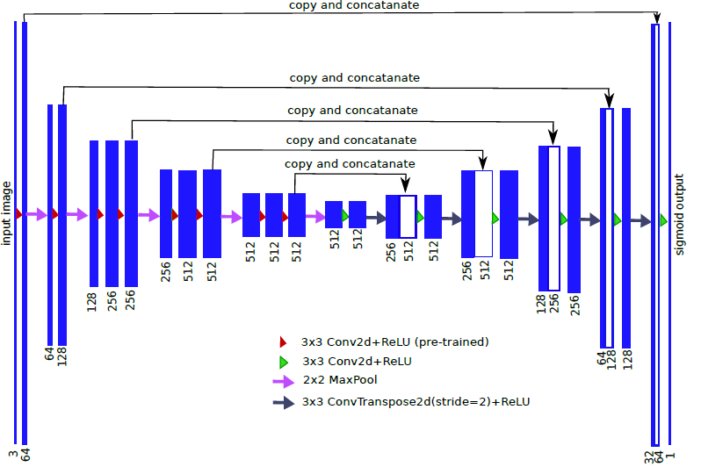
TernausNet

Slide 5
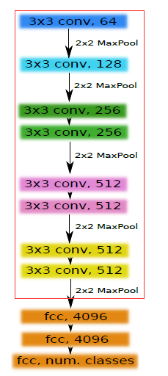
TernausNet
VGG11 network architecture. In this picture each convolutional layer is followed by ReLU activation function. The number in each box represents the number of channels in the corresponding feature map.

Slide 6
TernausNet
Datasets
Inria Aerial Image Labeling Dataset. It consists of 180 aerial images of urban settlements in Europe and United States, and is labeled as a building and not building.
Validation : 30 images(5 from every 6 cities in train set)
Training: train the network on remaining 150 images for 100 epochs
Optimization --- Evaluation Metrix
Adam with learning rate 0.001 as an optimization algorithm.
Choose Jaccrd index (Intersection Over Union, IoU) as evaluation metrix.
Notes:
Inria 航空影像标签数据集
总共：180张（5000， 5000， 3）彩色图像,训练集150张，验证集30张
-Random crops of 768*768 were used for training and central crops 1440*1440 for validation.
-训练集是随机裁剪768*768像素大小的patches
-验证集是中心裁剪1440*1440像素大小的patches
Jaccrd index 用于比较有限样本集之间的相似性和差异性, jaccard值越大说明相似度越高

Slide 7
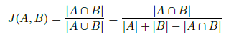
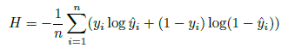
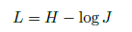
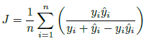
TernausNet
Jaccrd index
Loss function
Notes:
Jaccrd index 用于比较有限样本集之间的相似性和差异性
损失函数，最大化J,即logJ,最小化L

Slide 8
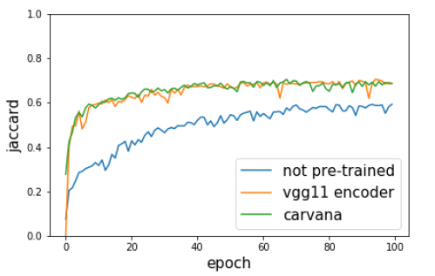
TernausNet
0.593
0.686
0.687

Slide 9
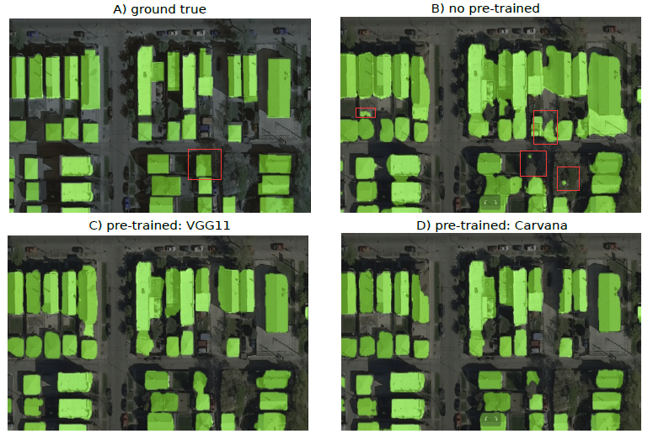
TernausNet

Slide 10

Thanks!!!

